Slide 1
Introduction to Computer Graphics
Course Title: Computer Graphics
Course Code: CSE - 413
Khandaker Jannatul Ritu, Lecturer(CSE), BAIUST

Slide 2
Books & Resources to follow
Reference Book(s):
1. Computer Graphics Principle and Practice -- James D Foley, Van Dam
2. Computer Graphics Using Open GL – F S Hill J R
3. OpenGL programming Guide-( Official guide to learning opengl )
Reference websites to follow:-
https://www.javatpoint.com/computer-graphics-tutorial
https://www.geeksforgeeks.org/computer-graphics-2/
https://www.tutorialspoint.com/computer_graphics/index.htm
https://www.gatevidyalay.com/computer-graphics/
Recommended YouTube playlists:-
https://www.youtube.com/playlist?list=PLMW5djzR9cKMs2_R1c59401IVQOMOs0pr
https://www.youtube.com/playlist?list=PLncy2sD7w4YpWn8jM9Sk6ISOsCZ7oLn9r
https://www.youtube.com/playlist?list=PLrjkTql3jnm9cY0ijEyr2fPdwnH-0t8EY
https://www.youtube.com/playlist?list=PLYwpaL_SFmcAtxMe7ahYC4ZYjQHun_b-T
Khandaker Jannatul Ritu, Lecturer(CSE), BAIUST

Slide 3
Outlines Of This Lecture
Introduction Of Computer Graphics
Picture, Photo, Image
Cg Vs Ip
Application Of Computer Graphics
Graphics Software
Types Of Computer Graphics:- Interactive And Passive Graphics
Introduction To Graphics Systems
Cathode Ray Tube(crt) Or Refresh CRT
Operations Of Cathode Ray Tube(crt) Or Refresh CRT
Properties Of Cathode Ray Tube(crt) Or Refresh CRT
Pixel Vs Points
Pixel Resolution
Pixel Calculation
Bpp
Img Size
Megapixels
Shades
Maths
Aspect Ratio
What Do You Mean By Aspect Ration 4:3?
Common Aspect Ratio
Advantages Of Aspect Ratio
Aspect Ratio Maths
Pixel Density Maths
Khandaker Jannatul Ritu, Lecturer(CSE), BAIUST

Slide 4
Introduction of Computer Graphics
Graphics are defined as any sketch or a drawing or a special network that pictorially represents some meaningful information. Computer Graphics is used where a set of images needs to be manipulated or the creation of the image in the form of pixels and is drawn on the computer.
To plot some points on a computer screen to make an image
Computer graphics involves technology to accept, process, transform and present information in a visual form that also concerns with producing images using a computer
The study of creating, manipulating, and using visual images in the computer
An art of drawing pictures, lines, charts etc. on computer screen by using programming is known as computer graphics. The activities involved in computer graphics are computations, creation and manipulation of data. The images are generated and manipulated by a rendering tool known as computer graphics.
In computer graphics objects are presented as a collection of discrete pixel elements.
Khandaker Jannatul Ritu, Lecturer(CSE), BAIUST

Slide 5
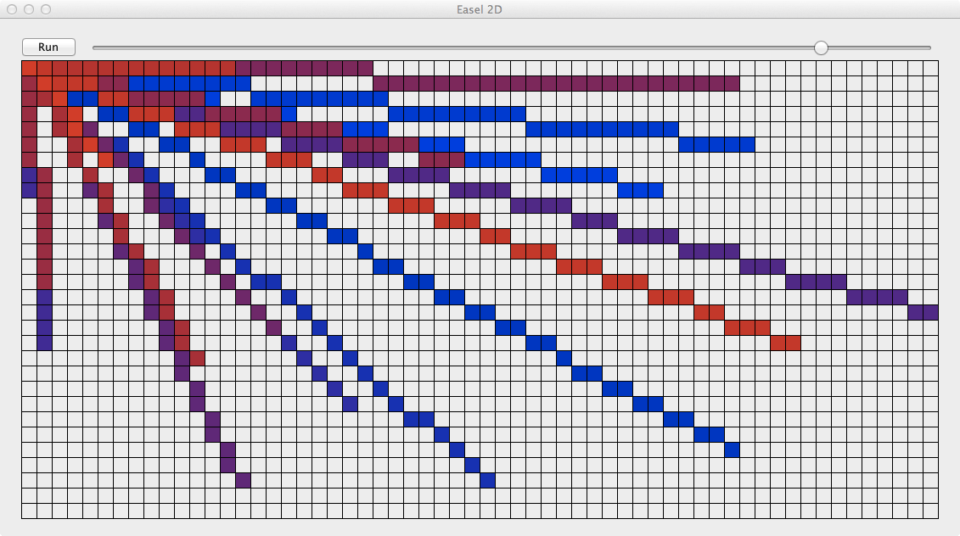
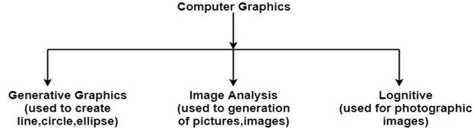
Computer Graphics refers to several things:
The manipulation and the representation of the image or the data in a graphical manner.
Various technology is required for the creation and manipulation.
Digital synthesis and its manipulation.
What is a Picture?
Picture — A drawing, painting, or artwork created on a computer.
What is a Photo?
Photo or photograph — Anything taken by a camera, digital camera, or photocopier.
What is an Image?
Image — Any visual object modified or altered by a computer or an imaginary object created using a computer. A picture that is store in some electronic form. Eg any picture file in your computer.
Khandaker Jannatul Ritu, Lecturer(CSE), BAIUST

Slide 6
Application of Computer Graphics
Computer graphics user interfaces GUIs
− A graphic, mouse-oriented paradigm which allows the user to interact with a computer.
Business presentation graphics − "A picture is worth a thousand words".
Cartography − Drawing maps.
Weather Maps − Real-time mapping, symbolic representations.
Satellite Imaging − Geodesic images.
Photo Enhancement − Sharpening blurred photos.
Medical imaging − MRIs, CAT scans, etc. - Non-invasive internal examination.
Engineering drawings − mechanical, electrical, civil, etc. - Replacing the blueprints of the past.
Educational Software: Computer Graphics is used in the development of educational software for making computer-aided instruction.
Entertainment − Movies and games.
Printing Technology: Computer Graphics is used for printing technology and textile design.
Visualization: It is used for visualization of scientists, engineers, medical personnel, business analysts for the study of a large amount of information.
Typography − The use of character images in publishing - replacing the hard type of the past.
Architecture − Construction plans, exterior sketches - replacing the blueprints and hand drawings of the past.
Art − Computers provide a new medium for artists.
Training − Flight simulators, computer aided instruction, etc.
Simulation and modeling − Replacing physical modeling and enactments
Khandaker Jannatul Ritu, Lecturer(CSE), BAIUST

Slide 7
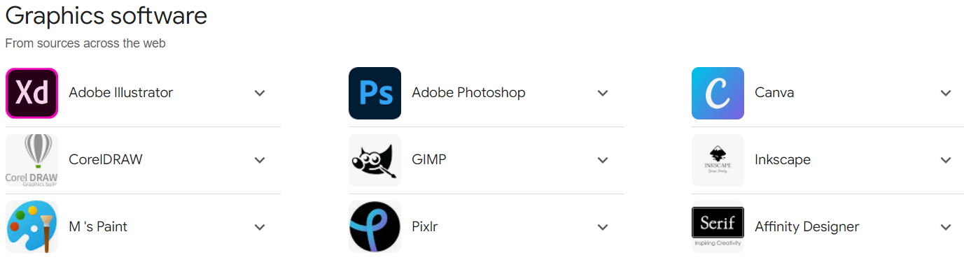
Khandaker Jannatul Ritu, Lecturer(CSE), BAIUST

Slide 8
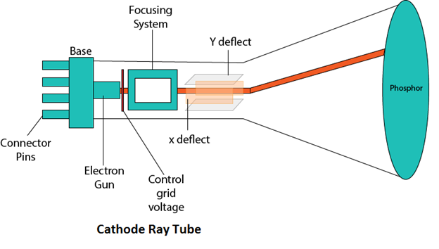
Graphics Monitor: Cathode ray tube(CRT) or refresh CRT
Definition:- Cathode ray tube(CRT) is vacuum tube containing an electron gun and a fluorescent screen to accelerate and deflect the electron beam, used to create images in the form of light emitted from florescent screen.
The image may represent electrical waveforms(oscilloscope), pictures(tv, monitor), radar targets and others.
Components of CRT/ operations of CRT:-
Electron gun
Control grid
Heating filament
Focusing system
accelerating anodes
Deflection system
Phosphor coated screen
Khandaker Jannatul Ritu, Lecturer(CSE), BAIUST

Slide 9
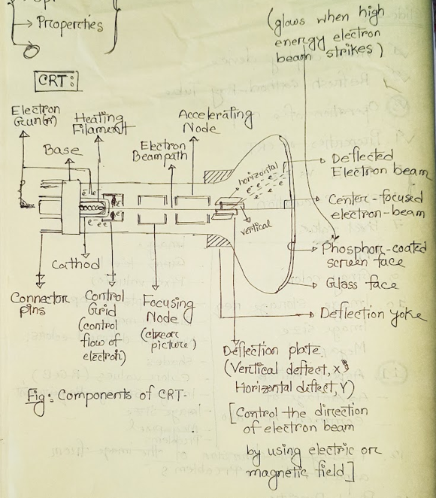
Khandaker Jannatul Ritu, Lecturer(CSE), BAIUST

Slide 10
Operations Of CRT:-
1. Electron gun:
it consist of control grid & heating filament which emits beams of electron(cathode rays). the electron beam passes through focusing and deflection system that direct it towards specified positions on the phosphor-coated screen. when the beam hits the screen, the phosphor emits a small spot of light at each position contacted by the electron beam. the light emitted by the phosphor fades very rapidly therefore to keep the picture it is necessary to keep the picture glowing. This is achieved through redrawing the picture repeatedly by quickly directing the electron beam back over the same points & display using this technique is called refresh CRT.
2. Control grid: controls the flow of electrons(e-) emitted by the electron gun.
3. Heating filament: heat is supplied to the cathode by directing current through filament. heat causes the electrons(e-) to be boiled off the hot cathode surface.
4. Focusing node: it is used to create a clear picture by focusing the electrons into a narrow beam. the responsibility of focusing system is to converge electron beam to a small spot where it strikes the phosphor. otherwise, the e- will repeat each other and beam would disperse.
5. Accelerating anode: negatively charged electron are then accelerated towards the phosphor coating by a high-definition positive voltage.
6. Deflecting system: it consist of horizontal & vertical deflection plate. it controls the directions of electron beam by using electric or magnetic field.
7. Phosphor-coated screen: it glows when the high-energy electron beam strikes the screen.

Slide 11
Properties of CRT:
1. Persistence: It is defined as the time it takes the emitted light from the phosphor to decay to one-tenth(1/10-th) of it's original intensity. It means how long they continue to emit light after the e-beam is removed.
Persistence range from 1- to 60 micro-seconds.
In short, Persistence is the duration of phosphorescence exhibited b y a phosphor.
2. Refreshing of the screen: It is done by keeping the phosphorous glowing to redraw the picture repeatedly. By quickly directing the electron beam back to the same points.
3. Refresh rate: It is the number of time per second the image is redrawn on the screen.
4. Critical Fusion Frequency(CFF): It is the refresh rate at which the image stops flickering and fuses into a steady image.
5. Horizontal Scan Rate(HSN): It is the number of line that can be scanned per second by the CRT.
HSN = Refresh Rate * No. of scan line
6. Pixel: Smallest unit of a digital image that can be displayed and represented on a digital display device.
If a monitor has a property of 200ppi(pixel per inch), then there are 200pixel of per square inch.
7. Pixel Resolution: It is the number of points per inch that can be plotted horizontally and vertically.
If an image has M rows and N columns, then it's resolution can be defined as M X N

Slide 12
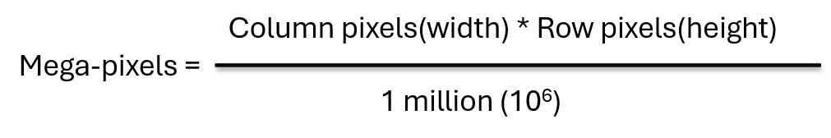
Pixel vs Point
Mega-pixels Calculations:
Pixel: A pixel is a point sample 'picture element', a single dot in your image.
A 10x10 image is made-up of a set of pixels = 100 pixels
Point: The point on the other hand is a unit of length 1pt is equally to exactly 1/72th of an inch.
if your image is 72ppi,
then 1 pt = 1 pixel
shades or Bit's Per Pixel: 2^{bpp}
Example-2: Image dimension = 2500 x 3192. What is the pixel resolution in megapixels?
Solution:
So, Pixel resolution = 2500 x 3192
= 7980000bytes
= 7980000 / 1000000
= 7.98 = 8 mega pixel(approximately)
Example-1: Assume a picture has 1024 rows and 1024 columns. What is the size of an image?[Assume there are 8-bits per pixel]
Solution:
Size of an image = row x col x bpp
= 1024 x 1024 x 8
= 8388608 bits
= 8388608/8 = 1048576 bytes
= 1048576/1024 = 1024Kb
= 1024/1024
= 1Mb

Slide 13
Problems:
1. What do you mean by resolution 800 x 600?
Solution: The resolution 800 x 600 refers to the number of pixels along the width (800 pixels) and height (600 pixels) of an image or display screen.
This means there are a total of 800×600=480,000 pixels in the image or display.
2. How many pixels for a 3 x 2-inch image at a resolution of 300 pixels per inch?
Solution: To find the total number of pixels, multiply the dimensions in inches by the resolution in pixels per inch (PPI):
Width in pixels=3×300=900 pixels
Height in pixels=2×300=600 pixels
Total pixels=900×600=540,000 pixels
3. Compute the size of a 640 x 480 image at 96 pixels per inch or how can measure a 640 x 480 image at 96 pixels per inch?
Solution: To find the size in inches, divide the pixel dimensions by the pixels per inch (PPI):
Width in inches = 640 / 96 ​≈ 6.67 inches
Height in inches = 480 / 96 ​≈ 5 inches
So, the size of the image is approximately 6.67 x 5 inches.
4. Compute the pixels per inch of a 2 x 2 inch image that has 512 x 512 pixels.
Solution: To find the PPI, divide the pixel dimensions by the size in inches:
Pixels per inch=512/2​=256 PPI
5. Compute the pixels per inch of a 3 x 2 inch image that has 900 x 600 pixels.
Solution: For the width and height, calculate the PPI separately (they should be the same if the image has uniform resolution):
Width PPI= 900 / 3 ​= 300 PPI
Height PPI= 600 / 2 ​=300 PPI
So, the pixels per inch (PPI) of the image is 300 PPI.

Slide 14
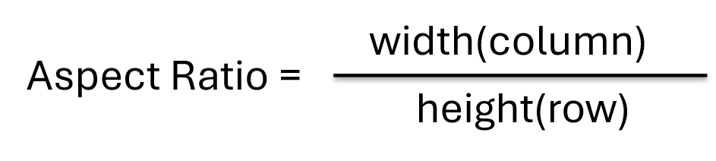
Aspect ratio:
Ratio of width to height of device.
It is the ratio of vertical points to horizontal point's necessary to produce equal-length lines in both direction on the screen.
An aspect ratio is a proportional relationship between on images width and height.
it is commonly explained as two numbers separated by a colon(:)
Advantage of Aspect Ratio:
1. Maintain a balance between the appearances of an image on the screen.
2. Maintain a ration between horizontal and vertical pixel
3. It does not let the image to get distorted
4. When the aspect ratio is increased that is the quality remains the same

Slide 15
What do you mean by aspect ratio 1:1?
it means that for every 1 units of width(column)
there are 1 units of height(row)
And, the height & width are same.
So, the image could be:
500px * 500px
1500px * 1500px
300px * 300px
This ration is commonly used in printing photographs, mobile screens, social media platforms.
What do you mean by aspect ratio 2:3?
it means that for every 2 units of width(column)
there are 3 units of height(row)
And, the image is 1.5(3/2)times higher than it is width
So, the image could be:
500px * 750px
1500px * 2250px
What do you mean by aspect ratio 4:3?
For Every 4 unit of width(column)
there are 3 unit of height(row)
And, the image is 1.33(4/3)times wider than it is high
So, the image could be:
400px * 300px
600px * 450px
1000px * 750px
This ration is commonly used in TV, PC monitor, Digital Camera
Q. What do you mean by aspect ratio 3:2?
Q. What do you mean by aspect ratio 16:9?

Slide 16
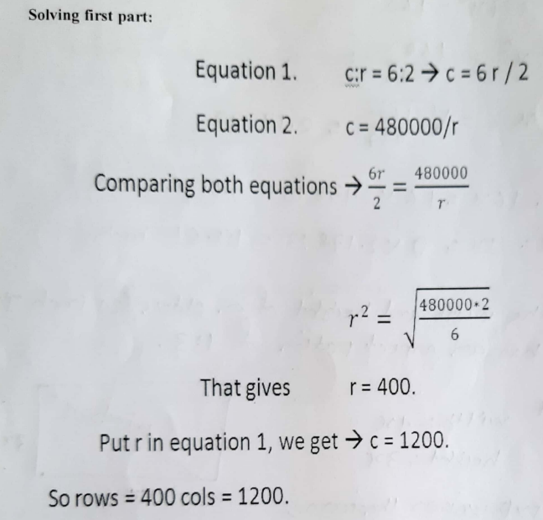
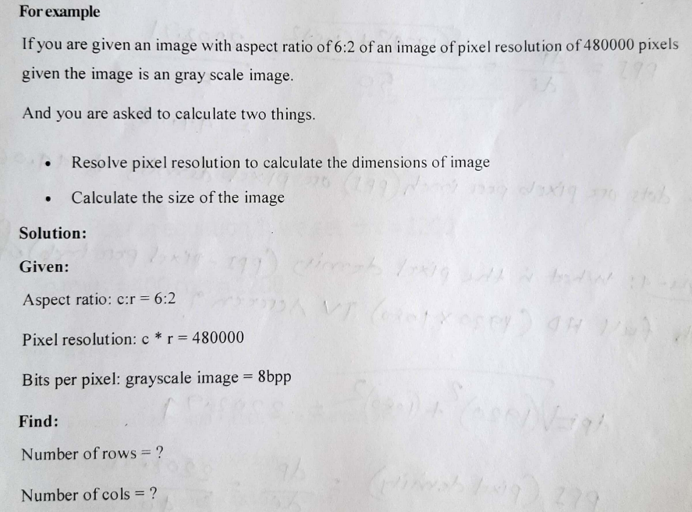
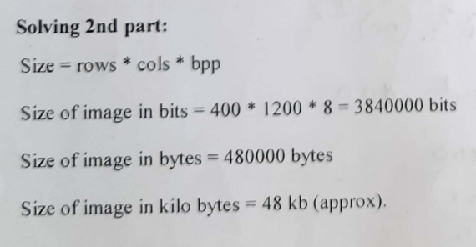
Aspect Ratio Solved Problems
Example-1:

Slide 17
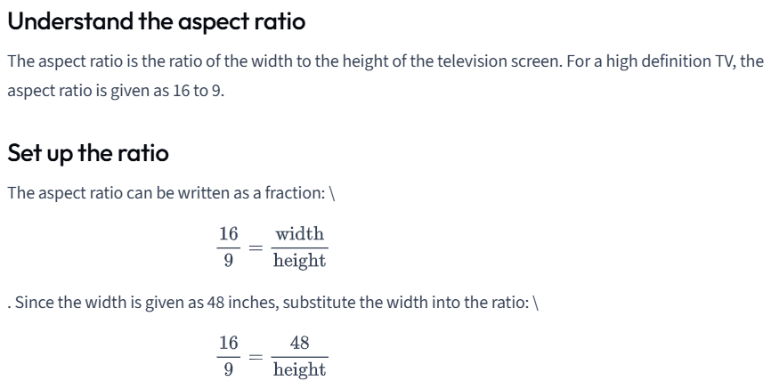
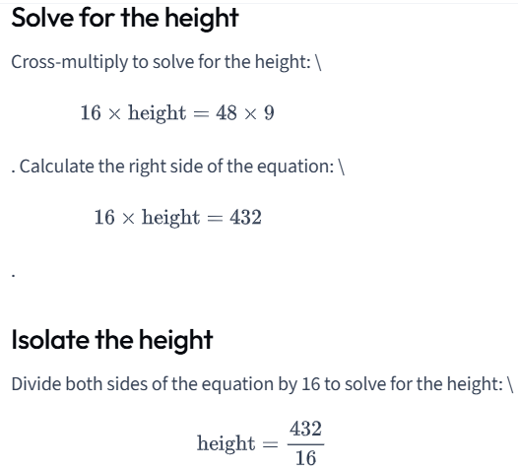
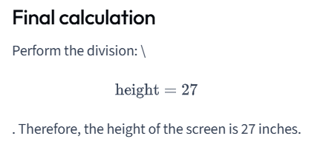
Example-2:
The aspect ratio for a television screen is the ratio of the width to the height of the screen. For a high definition TV it is 16 to 9. What is the height of a screen that is 48 inches wide?

Slide 18
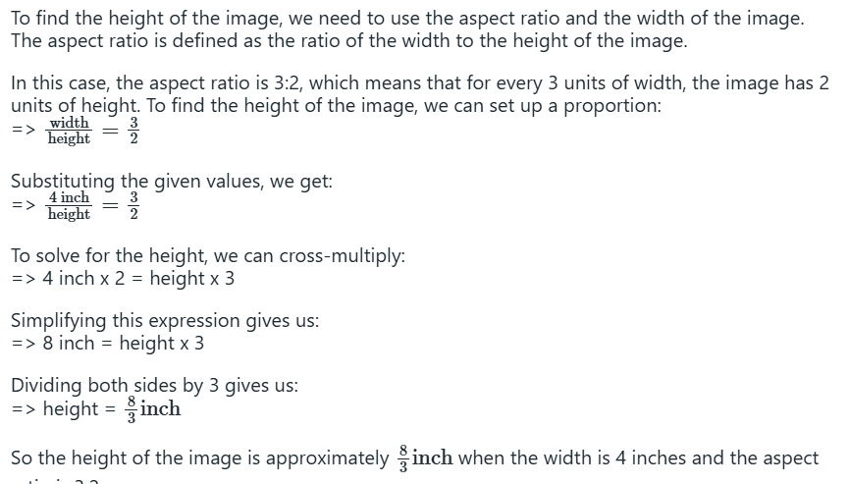
Example-3:
If an image has a width of 4 inch and an aspect ratio of 3:2, then what is its height?

Slide 19
Example-4:
If an image a height of 2 inches and an aspect ratio of 1.5, what is its width?
Calculating the width of an image with a height of 2 inches and an aspect ratio of 1.5:
The aspect ratio is given as 1.5, so
Width=Aspect Ratio × Height=1.5×2=3 inches
Example-5:
If we want to resize a 1024 x 768 image to one that is 640-pixels wide with the same aspect ratio, what would be the height of the resized image?
Resizing a 1024 x 768 image to a width of 640 pixels while maintaining the aspect ratio:
The aspect ratio is the ratio of width to height, which we calculate as:
Aspect Ratio=Width/Height​=1024​/768=1.3333
To maintain this aspect ratio with a width of 640 pixels, calculate the new height
New Height=New Width/Aspect Ratio​=640/ 1.3333​≈480 pixels

Slide 20
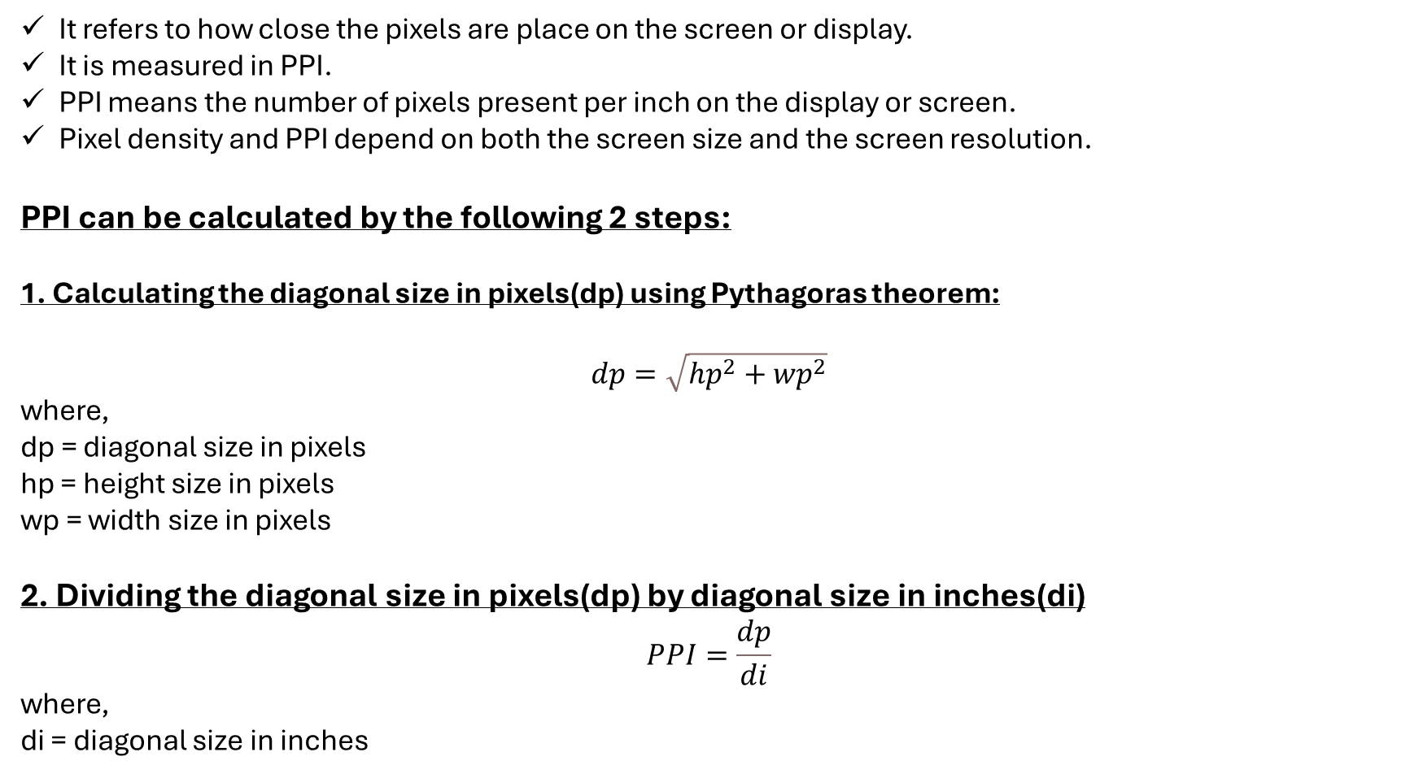
Pixel Density:
It refers to how close the pixels are place on the screen or display.
It is measured in PPI.
PPI means the number of pixels present per inch on the display or screen.
Pixel density and PPI depend on both the screen size and the screen resolution.
PPI can be calculated by the following 2 steps:
1. Calculating the diagonal size in pixels(dp) using Pythagoras theorem:
$$dp=\sqrt{{hp}^{2}+{wp}^{2}}$$
where,
dp = diagonal size in pixels
hp = height size in pixels
wp = width size in pixels
2. Dividing the diagonal size in pixels(dp) by diagonal size in inches(di)
$$PPI=\frac{dp}{di}$$
where,
di = diagonal size in inches

Slide 21
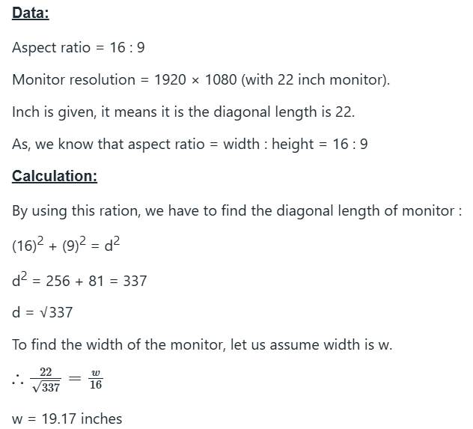
Pixel Density Solved Problems
1. Given that a 220-inch monitor with an aspect ratio of 16:9 has a monitor resolution of 1920 x 1080, what is the width of the monitor?

Slide 22
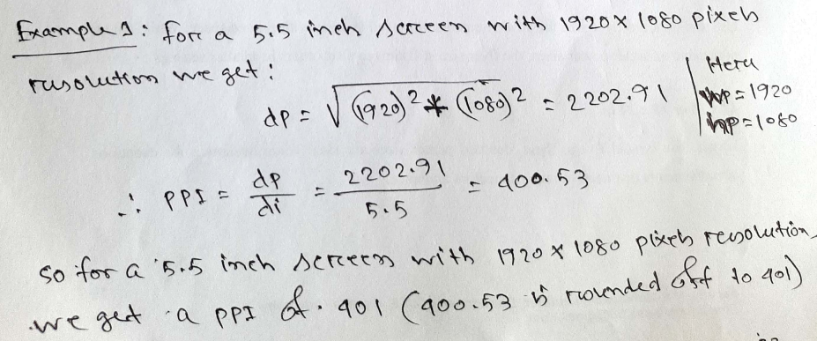
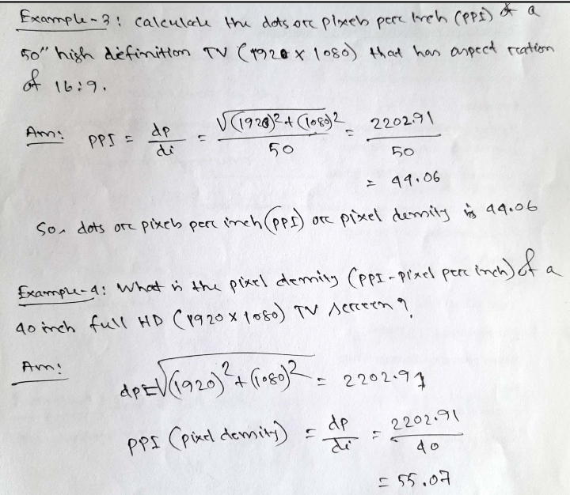
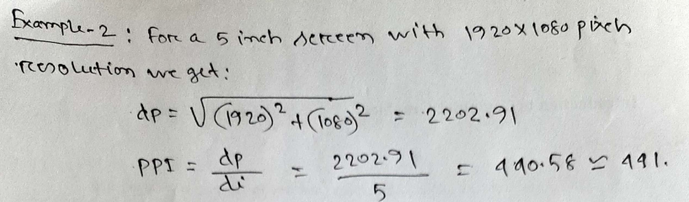

Slide 23
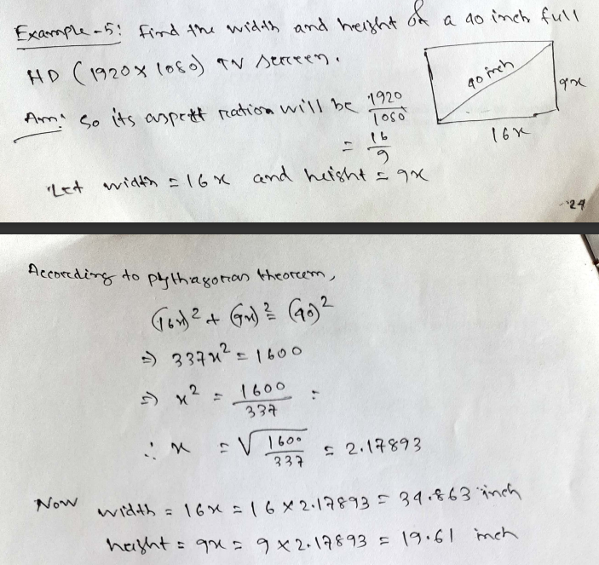
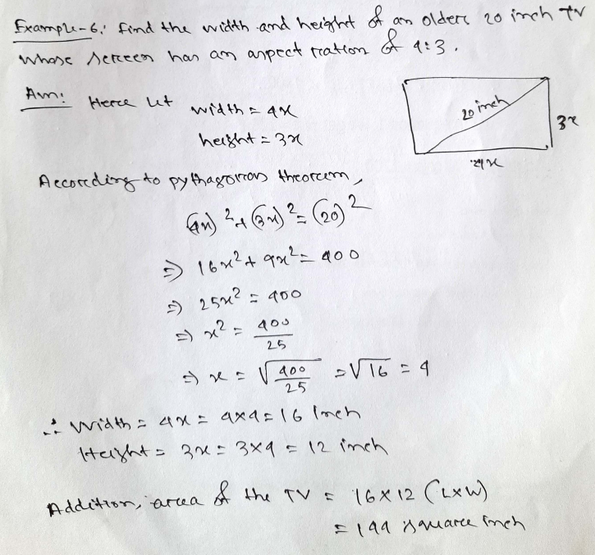

Slide 24
